Slide 1


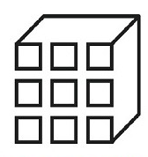




5G
Physical World
Digital World
Sensor Data Platform
BMS
Daylighting
Artificial Lighting
Occupancy
Parametric BIM
(i.e., Cooper
Lighting App)
Building Information
Modeling
Current energy
tracking
Temperature
Thermal Comfort
Data aggregator
middleware platform
Parametric Simulation
Modeling
Future energy
predictions
Weather data
Visual
Platform

Slide 2
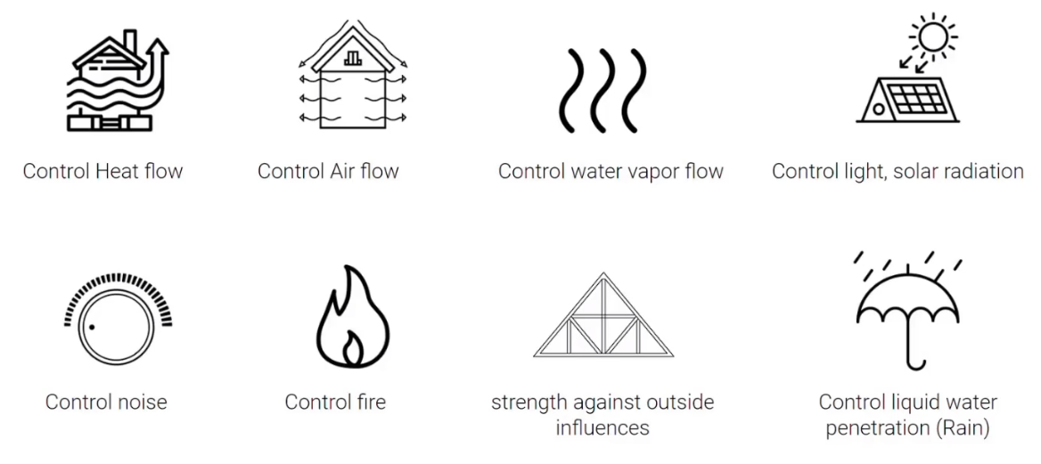
Smart Building Performance Parameters
Controlling
Lighting and
Solar Radiation
Controlling HVAC
Controlling Airflow & Noise
Controlling Water Vapor flow
24/7 monitoring
Controlling Fire
Considering Outer Influences
Considering Liquid
Penetration

Slide 3
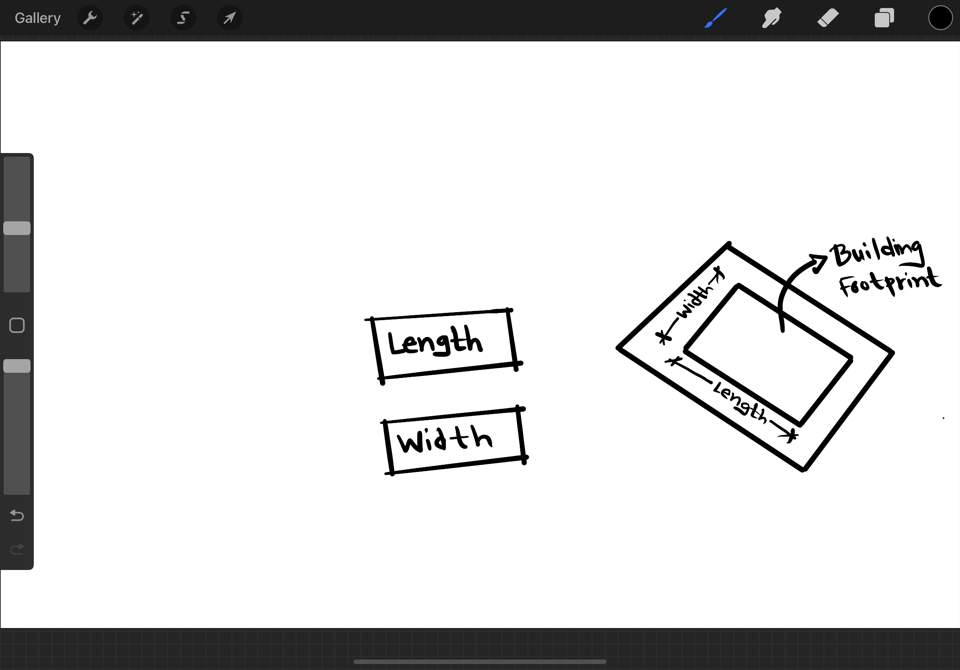
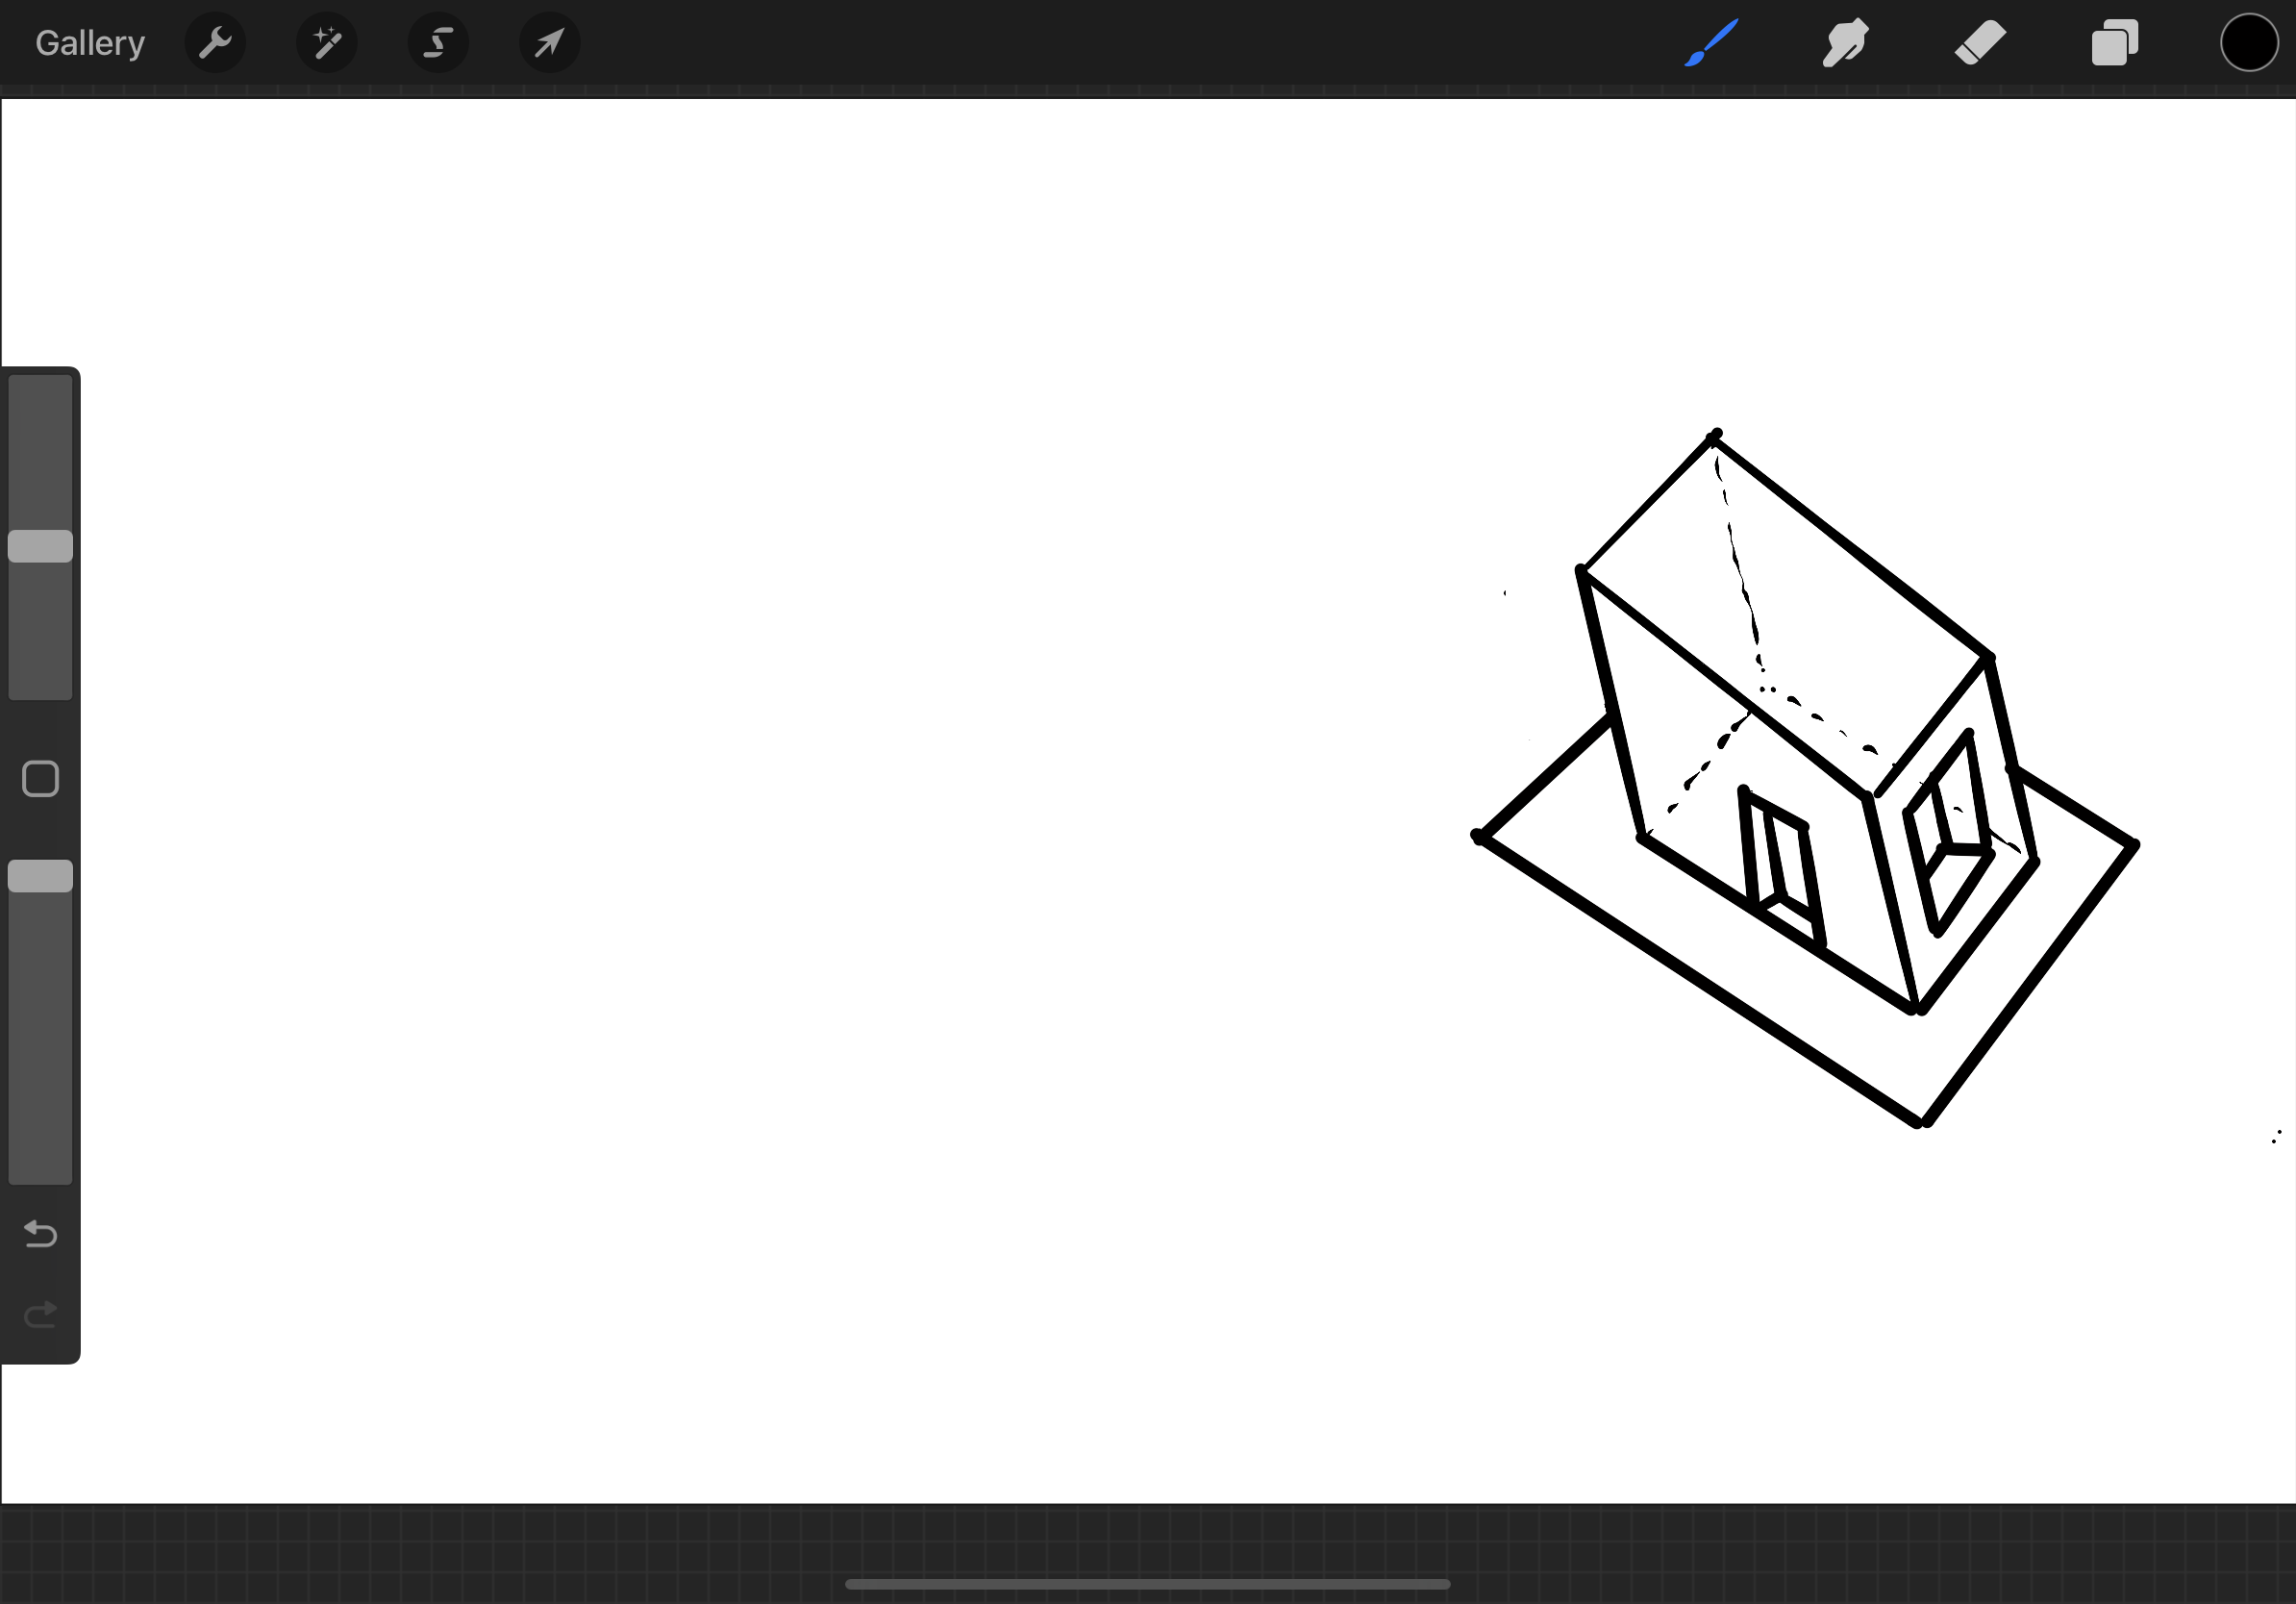
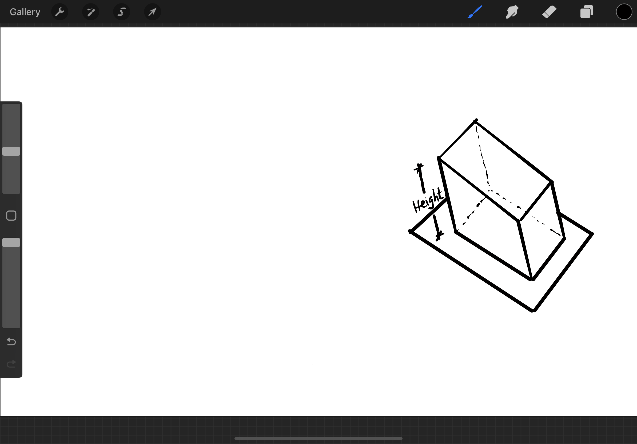
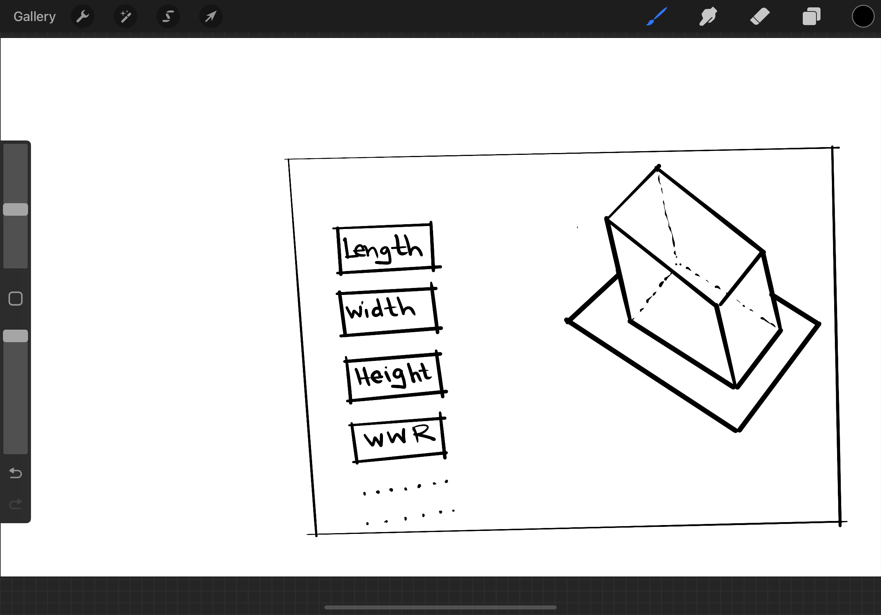
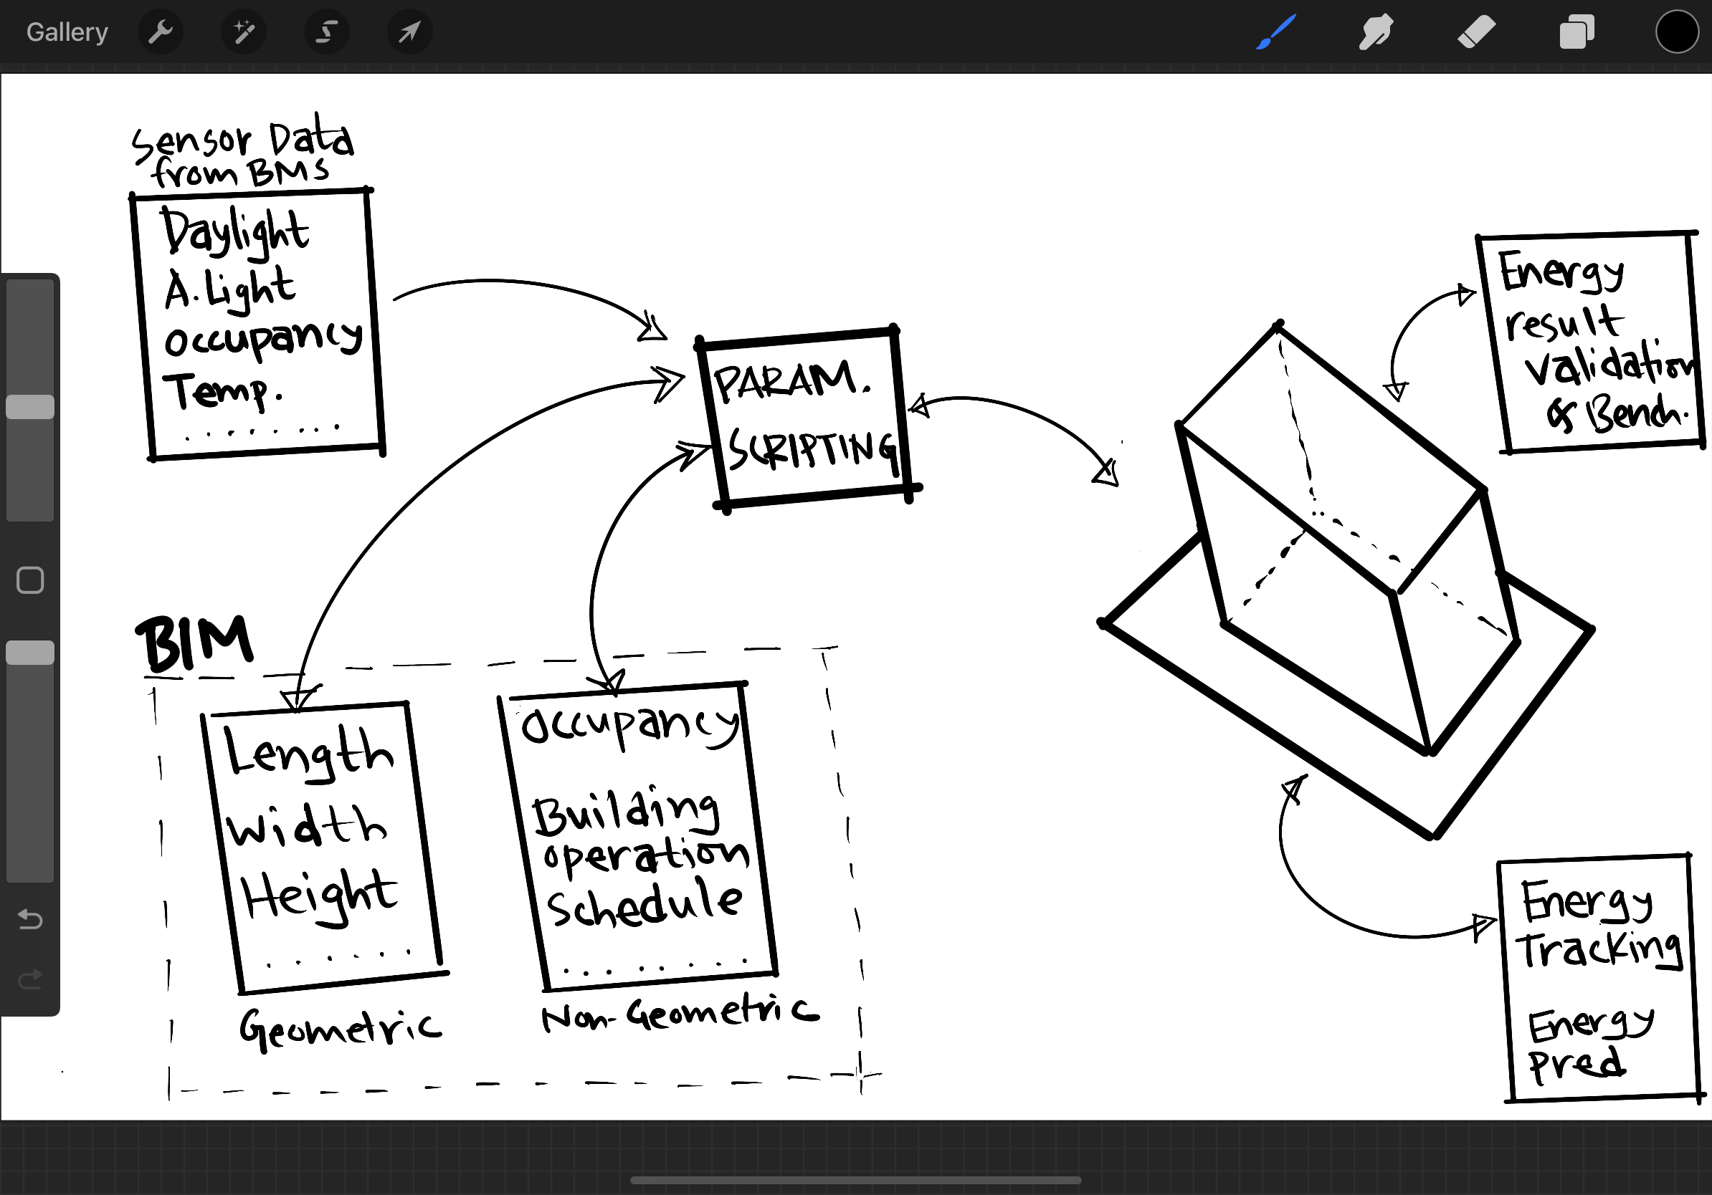

Slide 4
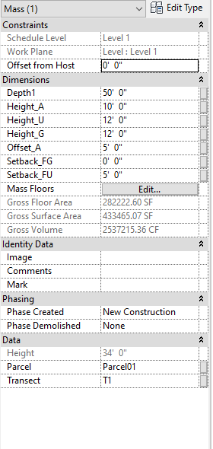
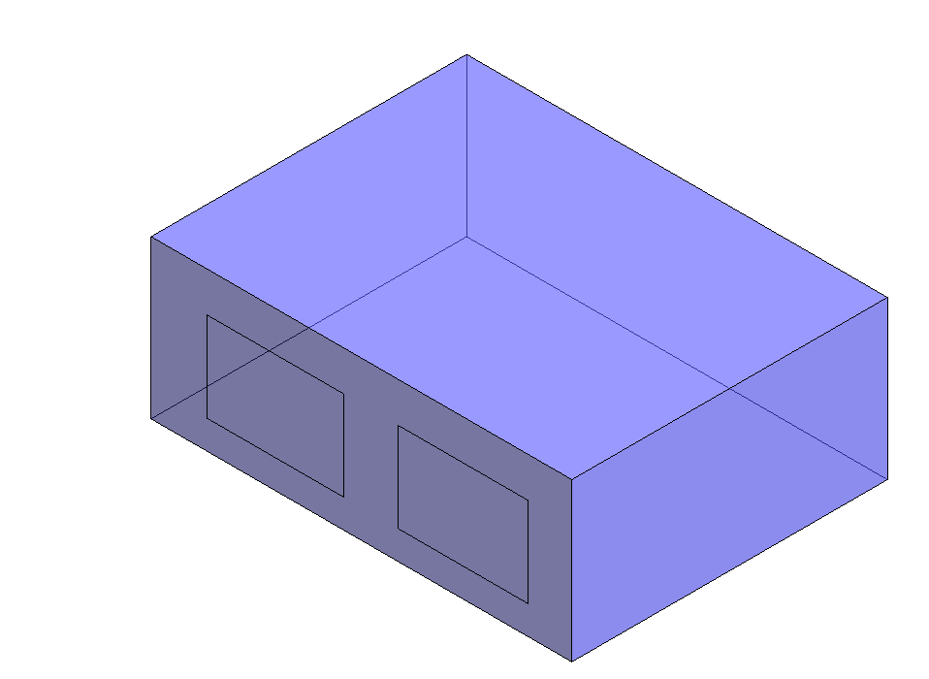

Slide 5
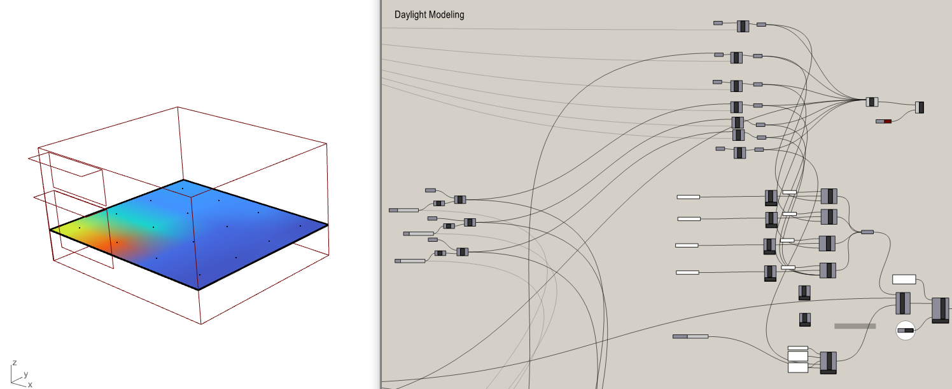

Slide 6
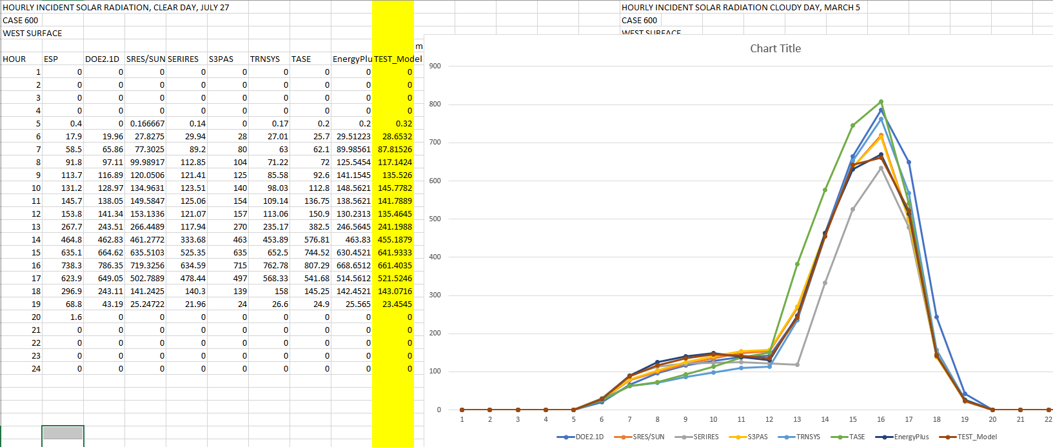

Slide 7
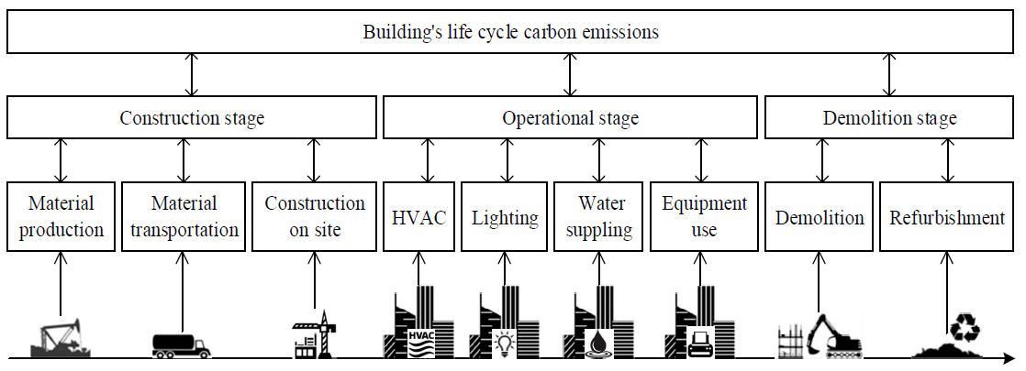
Notes:
The
CO2 emissions of the operational stage primarily include those
generated by heating, ventilation, and air conditioning (HVAC);
lighting; office equipment; elevators; and water pumps.

Slide 8
Heating load
Cooling load
Daylighting level
Artificial lighting level
Solar Radiation level
(Heating and cooling load change based on occupancy, ventilation, thermostat level etc.)
Everything need to be converted to KWH
Notes:
The
CO2 emissions of the operational stage primarily include those
generated by heating, ventilation, and air conditioning (HVAC);
lighting; office equipment; elevators; and water pumps.

Slide 9
Geometry/non-geometry related info
Energy Simulation in kwh
CO2 emission in lb/kwh
Prediction/performance/optimization based on current operations
Notes:
The
CO2 emissions of the operational stage primarily include those
generated by heating, ventilation, and air conditioning (HVAC);
lighting; office equipment; elevators; and water pumps.

Slide 10
Data & Model Generation
Location specific building
Converge geometric, non geometric & Sensor data
Simulation Interface
Physics-based algorithm
Save the training data for ML algorithm-based algorithm
Carbon Analysis
Building carbon performance
Building carbon prediction
3D Visualizer
Bring the prediction results
Bring the 3D BIM model
Bring the sensor data
VR Visualizer
Bring the dashboard to VR platform
QR code be used to see the results on exact points
Notes:
The
CO2 emissions of the operational stage primarily include those
generated by heating, ventilation, and air conditioning (HVAC);
lighting; office equipment; elevators; and water pumps.

Slide 11
Queries regarding Sensors
Is the server we have installed here at Mizzou a DB server?
How can we access the data from the server? As the data is stored in our server, do we need APIs?
Should we use Postman API or Trellix API? Is there any token information needed?
As we can see from the example image, real-time data is triggered whenever there is a change in room activity or weather. Can we set a fixed interval for collecting real-time data, such as every 1 minute?
Can we get a sample dataset so we can test it in our data workflow?
Notes:
The
CO2 emissions of the operational stage primarily include those
generated by heating, ventilation, and air conditioning (HVAC);
lighting; office equipment; elevators; and water pumps.

Slide 12


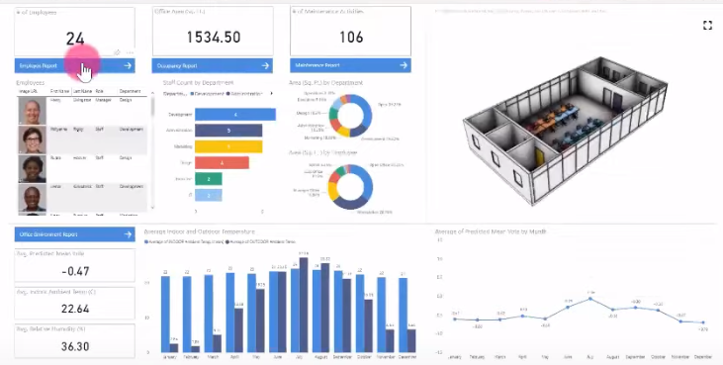

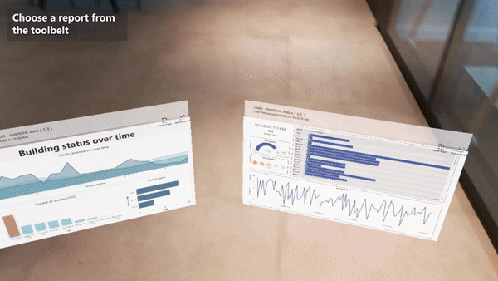
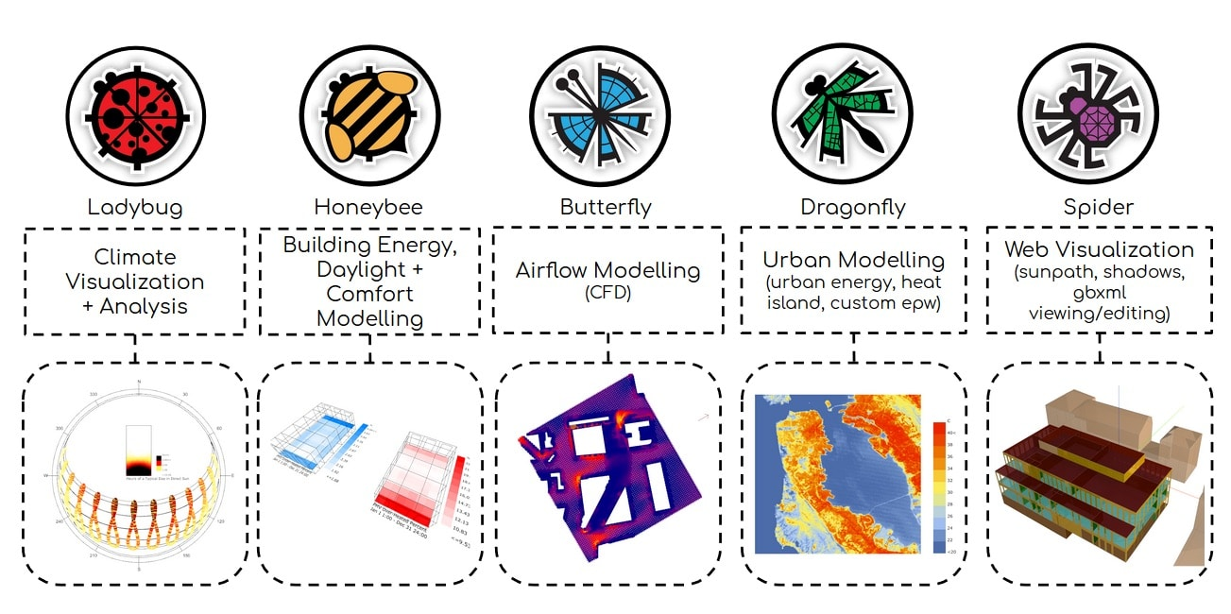




Data & Model Generation
Simulation Interface
Carbon Analysis
3D Visualizer
VR Visualizer
Location specific building
Converge geometric, non geometric & Sensor data
Physics-based algorithm
Save the training data for ML algorithm-based algorithm
Building carbon performance
Building carbon prediction
Bring the prediction results
Bring the 3D BIM model
Bring the sensor data
Bring the dashboard to VR platform
QR code be used to see the results on exact points
Geometric Data
GIS Shape file
Building Information Model
IFC for 3D visualization platform
Parametric Simulation Engine
3D Visualization Platform
VR/XR Platform
ML algorithm
Non-geometric Data
Weather data
Building Schedule (Template)
Occupancy, 3D building, Graphs of the CO2 performance & prediction
SAVE THE TRAINING DATA
Power BI---HoloLens 2
Sensor Data
Occupancy data
Daylighting/Lighting data
Thermal data

Slide 13
Data & Model Generation
Simulation Interface
Carbon Analysis
3D Visualizer
VR Visualizer
Location specific building
Converge geometric, non geometric & Sensor data
Physics-based algorithm
Save the training data for ML algorithm-based algorithm
Building carbon performance
Building carbon prediction
Bring the prediction results
Bring the 3D BIM model
Bring the sensor data
Bring the dashboard to VR platform
QR code be used to see the results on exact points
Geometric Data
GIS Shape file
Building Information Model
IFC for 3D visualization platform
Parametric Simulation
Engine
BMS
3D Visualization Platform
VR/XR Platform
ML algorithm
BIM Platform
Non-geometric Data
SAVE THE
TRAINING DATA
Input parameters
Weather data
Building Schedule (Template)
Occupancy, 3D building, Graphs of the CO2 performance & prediction
Power BI---HoloLens 2
Sensor Data
Occupancy data
Daylighting/Lighting data
Thermal data

Slide 14
5G
Physical World
Digital World
Sensor Data Platform
BMS
Daylighting
Artificial Lighting
Occupancy
Parametric BIM
(i.e., Cooper
Lighting App)
Building Information
Modeling
Current energy
tracking
Temperature
Thermal Comfort
Data aggregator
middleware platform
Parametric Simulation
Modeling
Future energy
predictions
Weather data
Visual
Platform

Slide 15
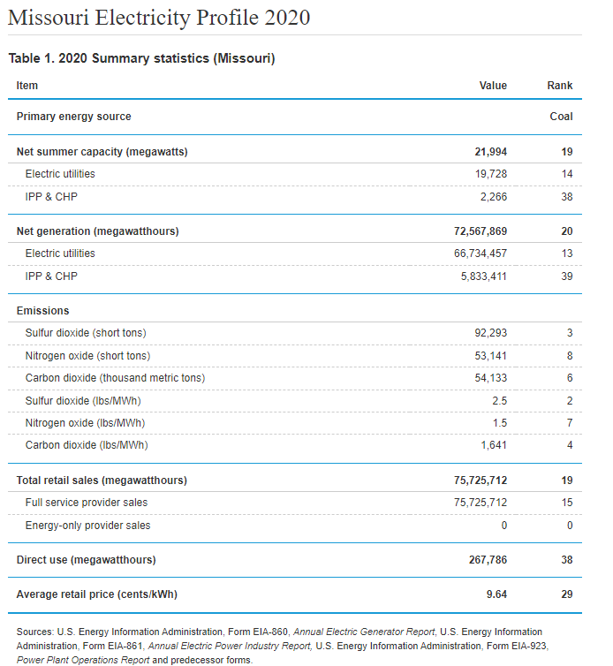
Carbon Emission
Most of the sulfur dioxide released into the environment comes from electric utilities, especially those that burn coal. Some other sources of sulfur dioxide include petroleum refineries, cement manufacturing, paper pulp manufacturing, and metal smelting and processing facilities.
Nitrogen dioxide comes from vehicles, power plants, industrial emissions and off-road sources such as construction, lawn and gardening equipment
https://www.eia.gov/electricity/state/missouri/
Notes:
The
CO2 emissions of the operational stage primarily include those
generated by heating, ventilation, and air conditioning (HVAC);
lighting; office equipment; elevators; and water pumps.

Slide 16
Carbon Emission Factor
https://www.eia.gov/tools/faqs/faq.php?id=74&t=11#:~:text=In%202020%2C%20total%20U.S.%20electricity,CO2%20emissions%20per%20kWh.
In 2020, total U.S. electricity generation by the electric power industry of 4.01 trillion kilowatthours (kWh) from all energy sources resulted in the emission of 1.55 billion metric tons—1.71 billion short tons—of carbon dioxide (CO₂). This equaled about 0.85 pounds of CO₂ emissions per kWh.
Notes:
The
CO2 emissions of the operational stage primarily include those
generated by heating, ventilation, and air conditioning (HVAC);
lighting; office equipment; elevators; and water pumps.

Slide 17
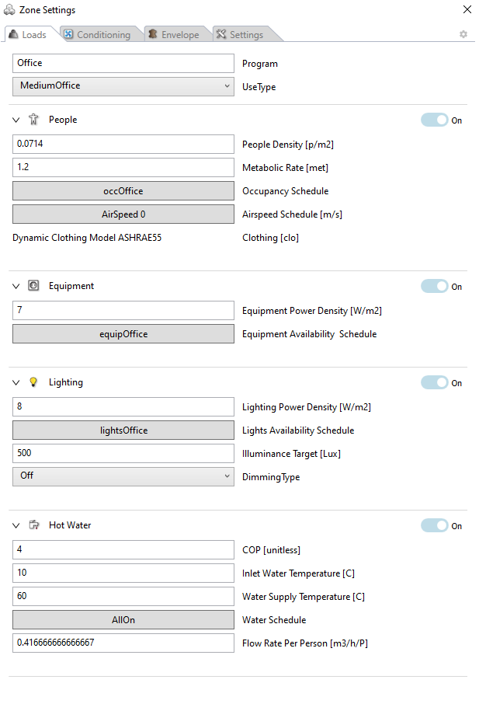
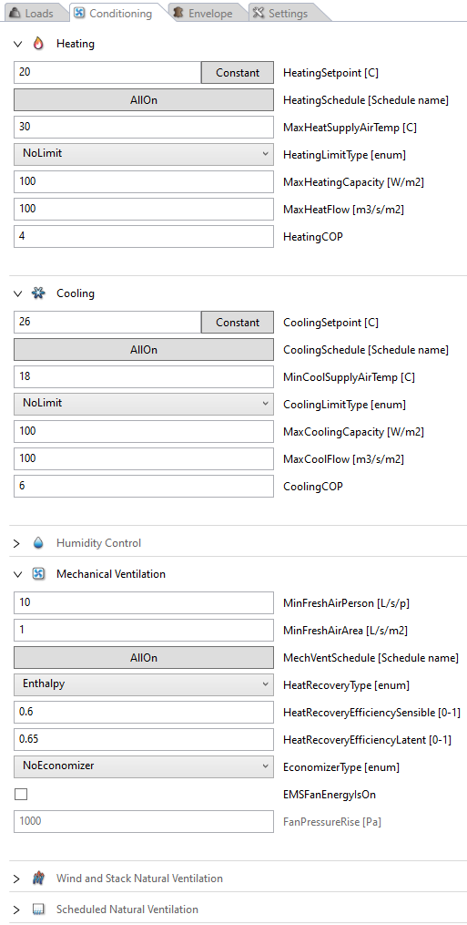
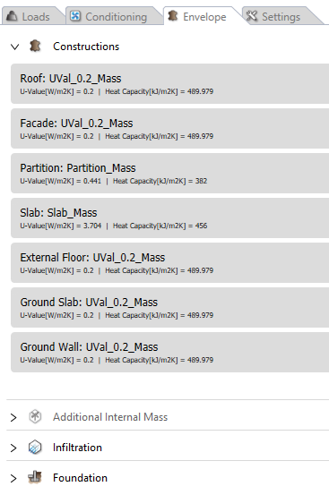
Parameter list
Indoor temperature
Outdoor temperature
Humidity
Occupancy
HVAC
Indoor lighting
Outdoor lighting
Notes:
The
CO2 emissions of the operational stage primarily include those
generated by heating, ventilation, and air conditioning (HVAC);
lighting; office equipment; elevators; and water pumps.

Slide 18
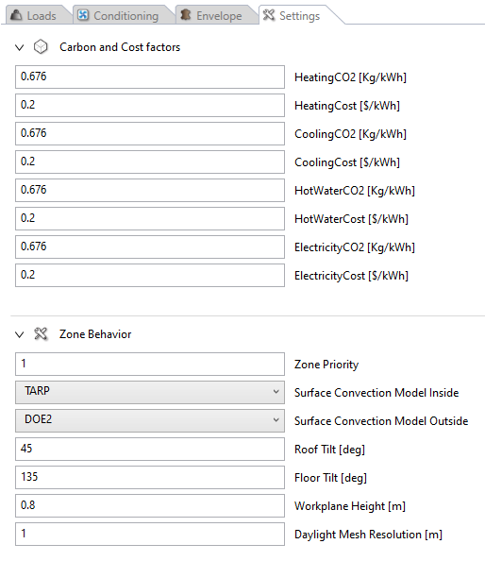
Load [kWh/m2/hr] to CO2 [kg/kWh]
Electricity Emission Factor CO2 [kg/kWh] for Missouri
Notes:
The
CO2 emissions of the operational stage primarily include those
generated by heating, ventilation, and air conditioning (HVAC);
lighting; office equipment; elevators; and water pumps.

Slide 19
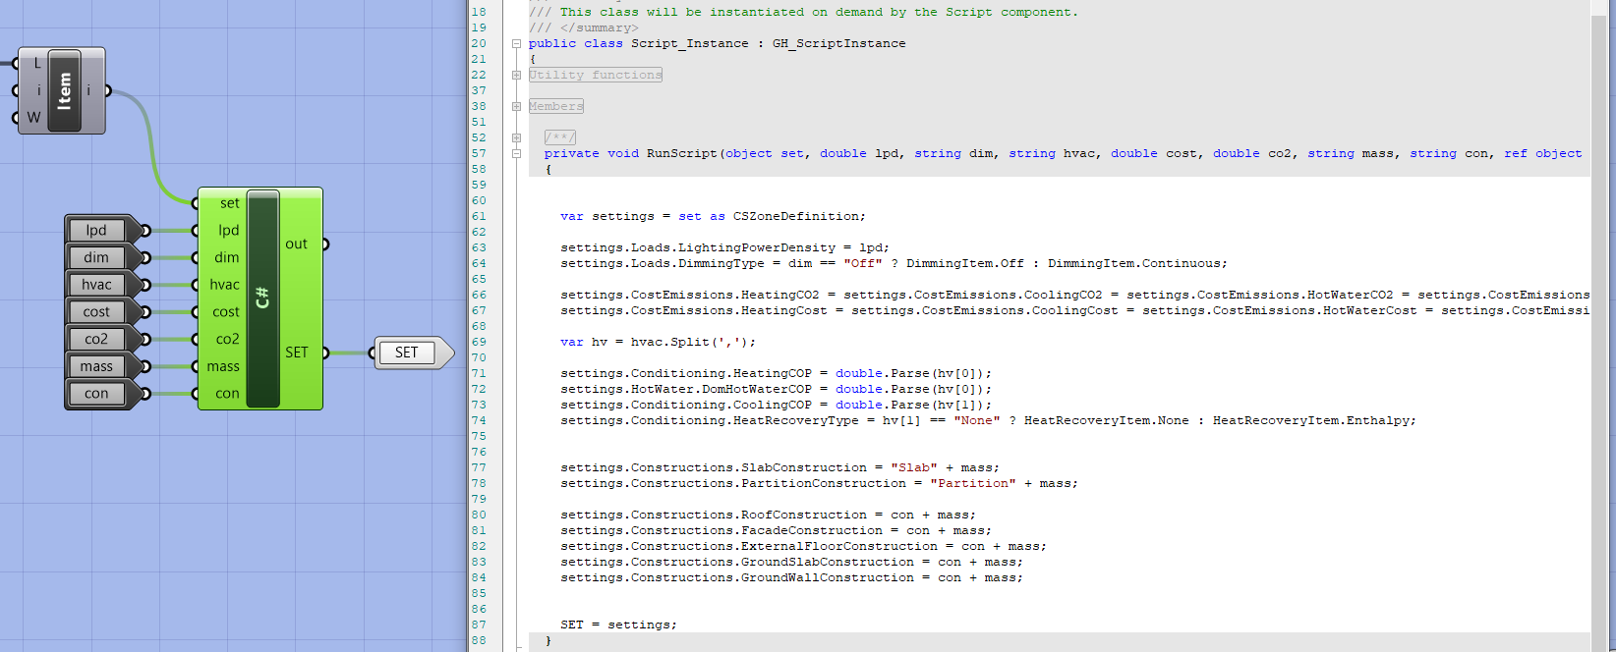
Settings for sensor data inclusion in the platform
Notes:
The
CO2 emissions of the operational stage primarily include those
generated by heating, ventilation, and air conditioning (HVAC);
lighting; office equipment; elevators; and water pumps.

Slide 20
Data & Model Generation
Simulation Interface
Carbon Analysis
3D Visualizer
Location specific building
Converge geometric, non geometric & Sensor data
Physics-based algorithm
Save the training data for ML algorithm-based algorithm
Building carbon performance
Building carbon prediction
Bring the prediction results
Bring the 3D BIM model
Bring the sensor data
Geometric Data
GIS Shape file
Building Information Model
IFC for 3D visualization platform
Parametric Simulation Engine
3D Visualization Platform
ML algorithm
Non-geometric Data
Weather data
Building Schedule (Template)
Occupancy, 3D building, Graphs of the CO2 performance & prediction
SAVE THE TRAINING DATA
Sensor Data
Occupancy data
Daylighting/Lighting data
Thermal data

Slide 21
Physical World
Digital World
Sensor Data Platform
BIM-based Simulation Platform
Daylighting
Artificial Lighting
Database
BIM Geometry
Visual Platform
Data Storage at APIs
CO2 Consumption
Physics-based Simulation integrating Geometry and Sensor data for CO2 calculation
Number of Occupants
Continuously updated data feeds using 5G connectivity
CO2 Prediction
Building Operations Hub
Data Query from APIs
Temperature
Humidity
Physics-based Simulation integrating Geometry and Sensor data for training and testing AI
Controller--Server
Data conversion into appropriate schema
Properties of Unknown Parameters for reducing CO2???
AI-based outputs for real-time CO2 calculation and Prediction
Microclimatic Data
Continuously updated CO2 consumption and prediction data back-propagated to building operations using 5G connectivity

Slide 22
Physical World
Digital World
Sensor Data Platform
BIM-based Simulation Platform
Daylighting
Artificial Lighting
Database
Building Information
Physics-based Simulation
Occupants
Continuously updated data feeds using 5G connectivity
Building Operations Hub
Data Storage, Query and Conversion
Temperature
Humidity
Training and testing data
Controller--Server
AI-based CO2 Tracking and Prediction
Weather data
Continuously updated CO2 consumption and prediction data back-propagated to building operations using 5G connectivity

